Slide 1
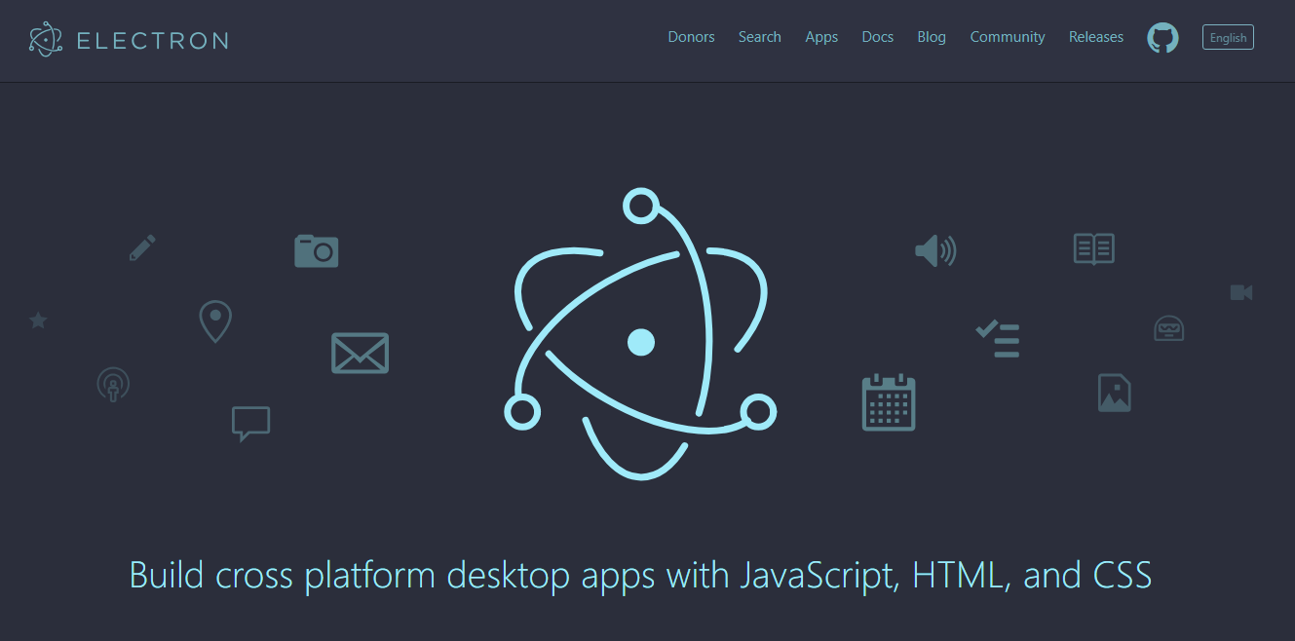

Level 200 Training
XD Studio
Trainers :
Sreenivas Nagineni
Tamilanban Devadoss

Slide 2
What is Electron?
Electron is an open source library developed by GitHub for building cross-platform desktop applications with HTML, CSS, and JavaScript. Electron accomplishes this by combining Chromium and Node.js into a single runtime and apps can be packaged for Mac, Windows, and Linux.

Slide 3
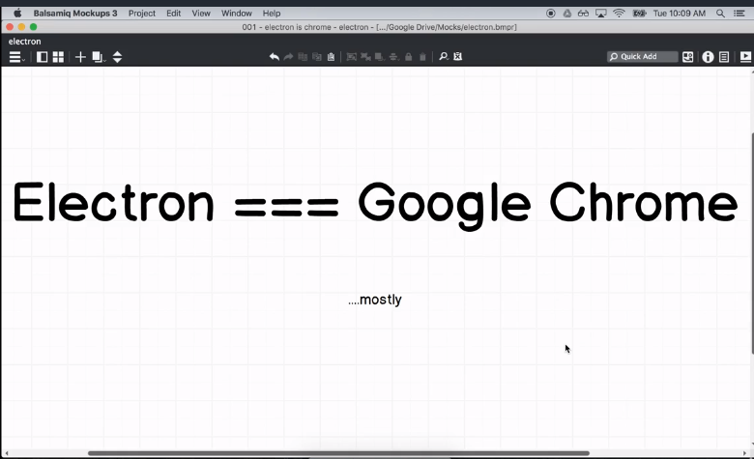
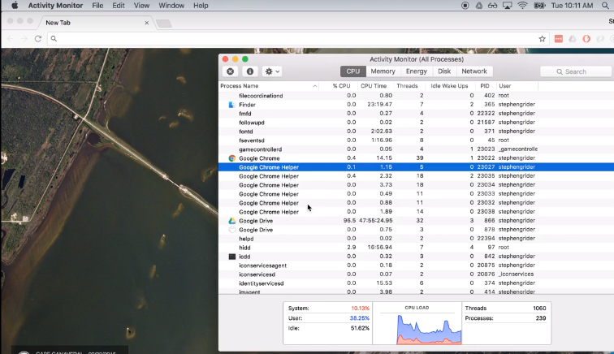
How does Electron works?
Electron is an open source library developed by GitHub for building cross-platform desktop applications with HTML, CSS, and JavaScript. Electron accomplishes this by combining Chromium and Node.js into a single runtime and apps can be packaged for Mac, Windows, and Linux.

Slide 4
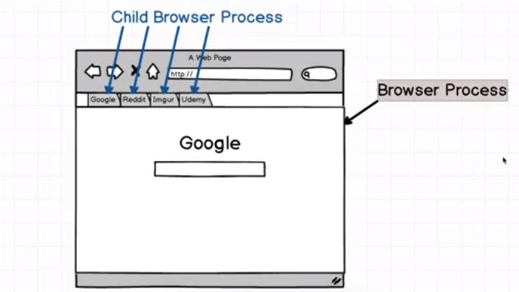
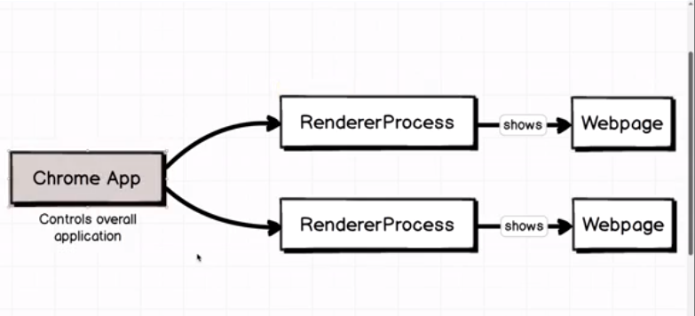
How does Electron works?
Electron is an open source library developed by GitHub for building cross-platform desktop applications with HTML, CSS, and JavaScript. Electron accomplishes this by combining Chromium and Node.js into a single runtime and apps can be packaged for Mac, Windows, and Linux.

Slide 5
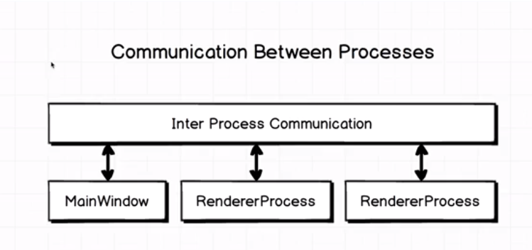
How does Electron works?
Electron is an open source library developed by GitHub for building cross-platform desktop applications with HTML, CSS, and JavaScript. Electron accomplishes this by combining Chromium and Node.js into a single runtime and apps can be packaged for Mac, Windows, and Linux.

Slide 6
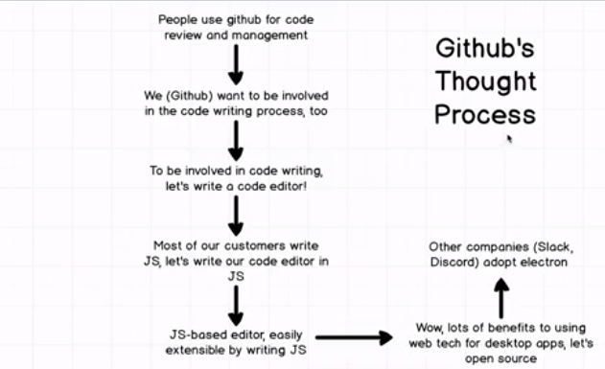
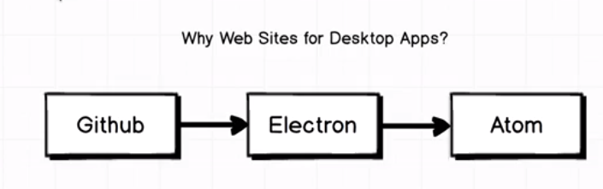
History of Electron
Electron is an open source library developed by GitHub for building cross-platform desktop applications with HTML, CSS, and JavaScript. Electron accomplishes this by combining Chromium and Node.js into a single runtime and apps can be packaged for Mac, Windows, and Linux.

Slide 7
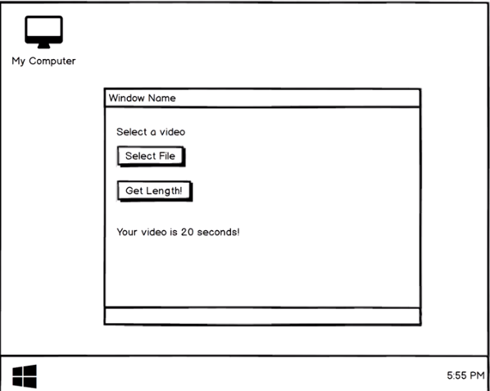
History of Electron
Electron is an open source library developed by GitHub for building cross-platform desktop applications with HTML, CSS, and JavaScript. Electron accomplishes this by combining Chromium and Node.js into a single runtime and apps can be packaged for Mac, Windows, and Linux.

Slide 8
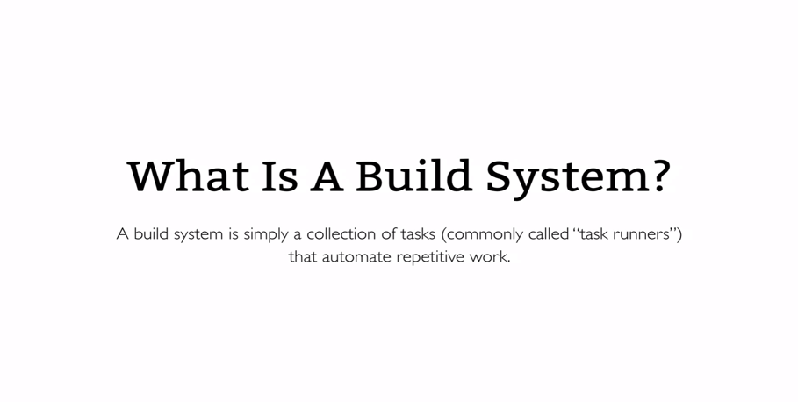

What is gulp?

Slide 9
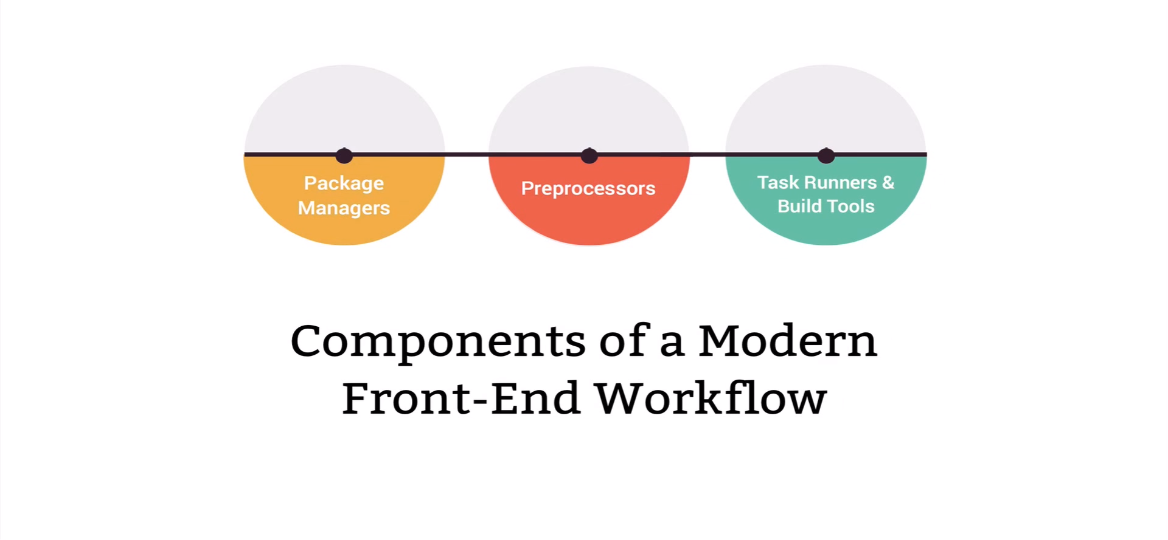
Components of FED Workflow

Slide 10
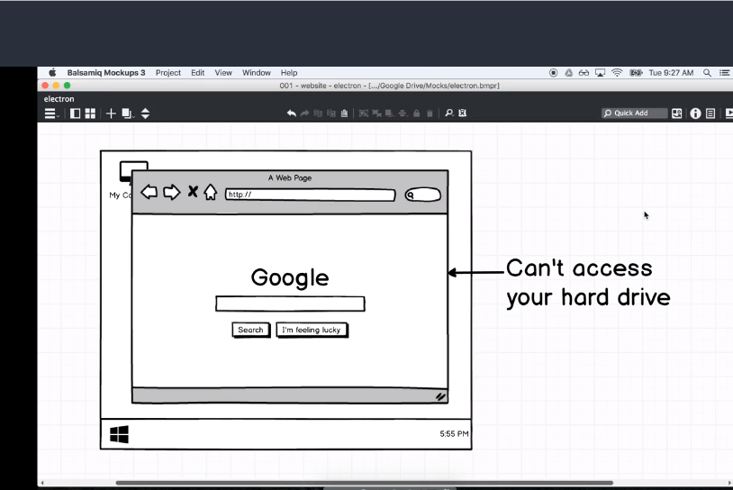
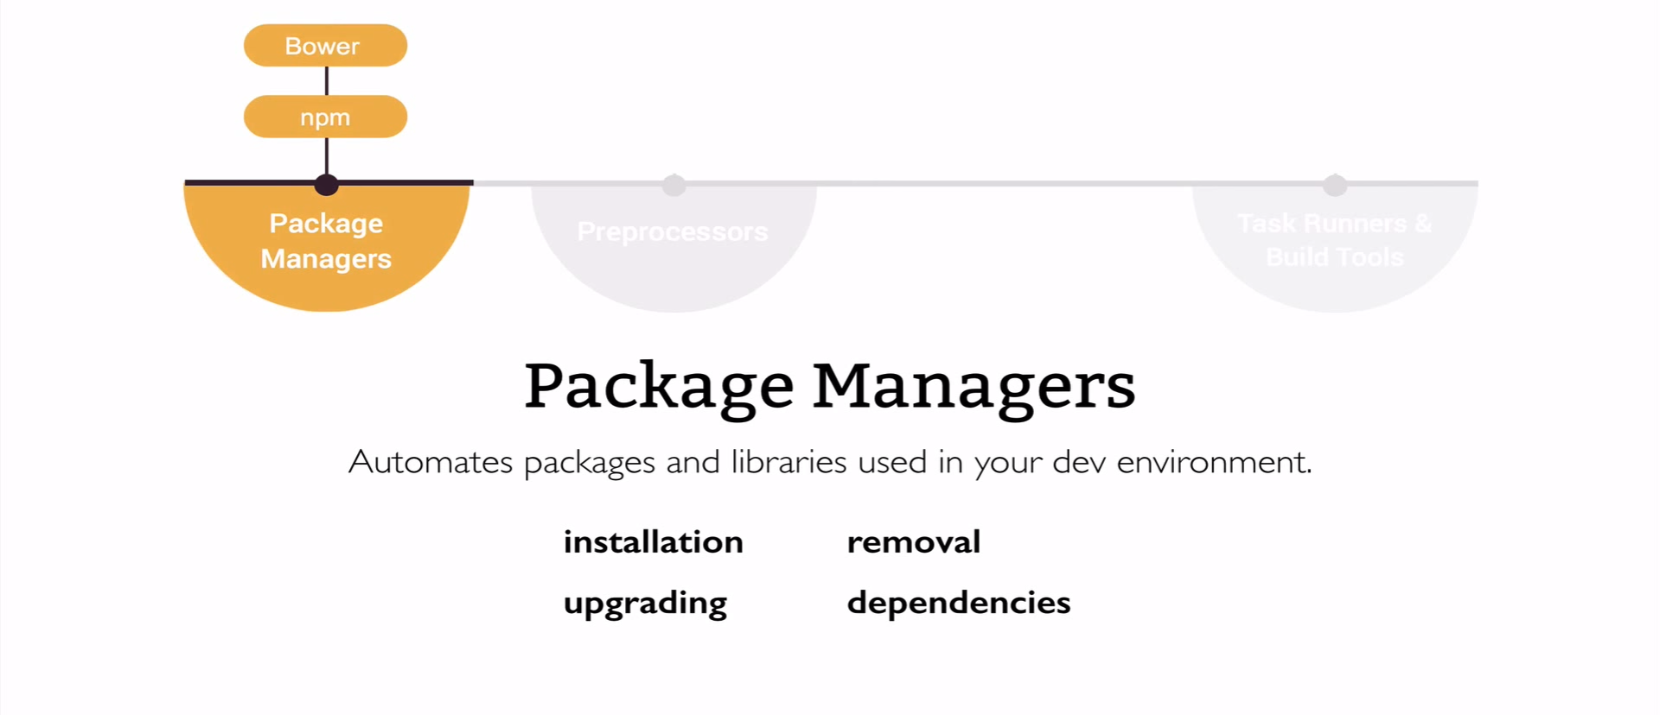
What are Package Managers

Slide 11

What are Package Managers

Slide 12

What are Package Managers

Slide 13
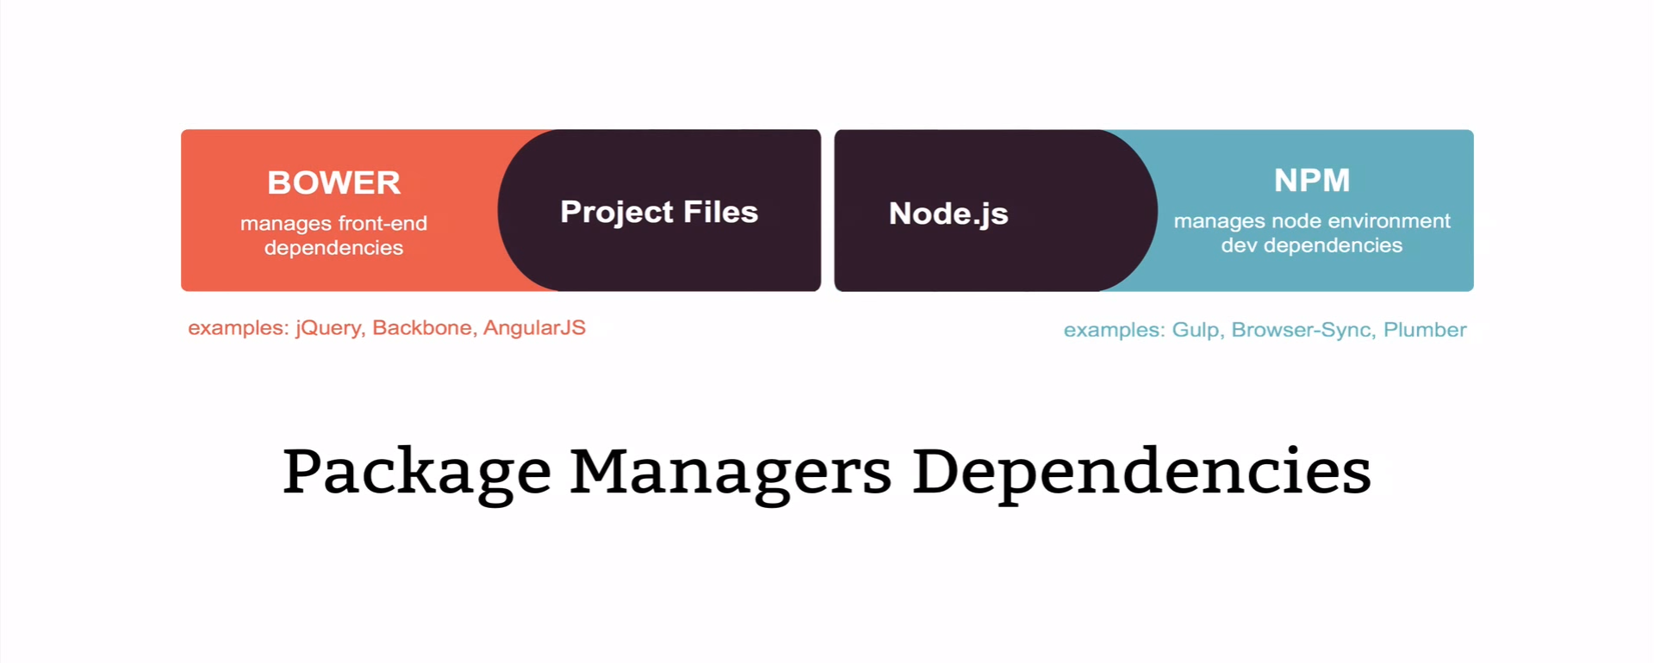
Package Managers Dependencies

Slide 14
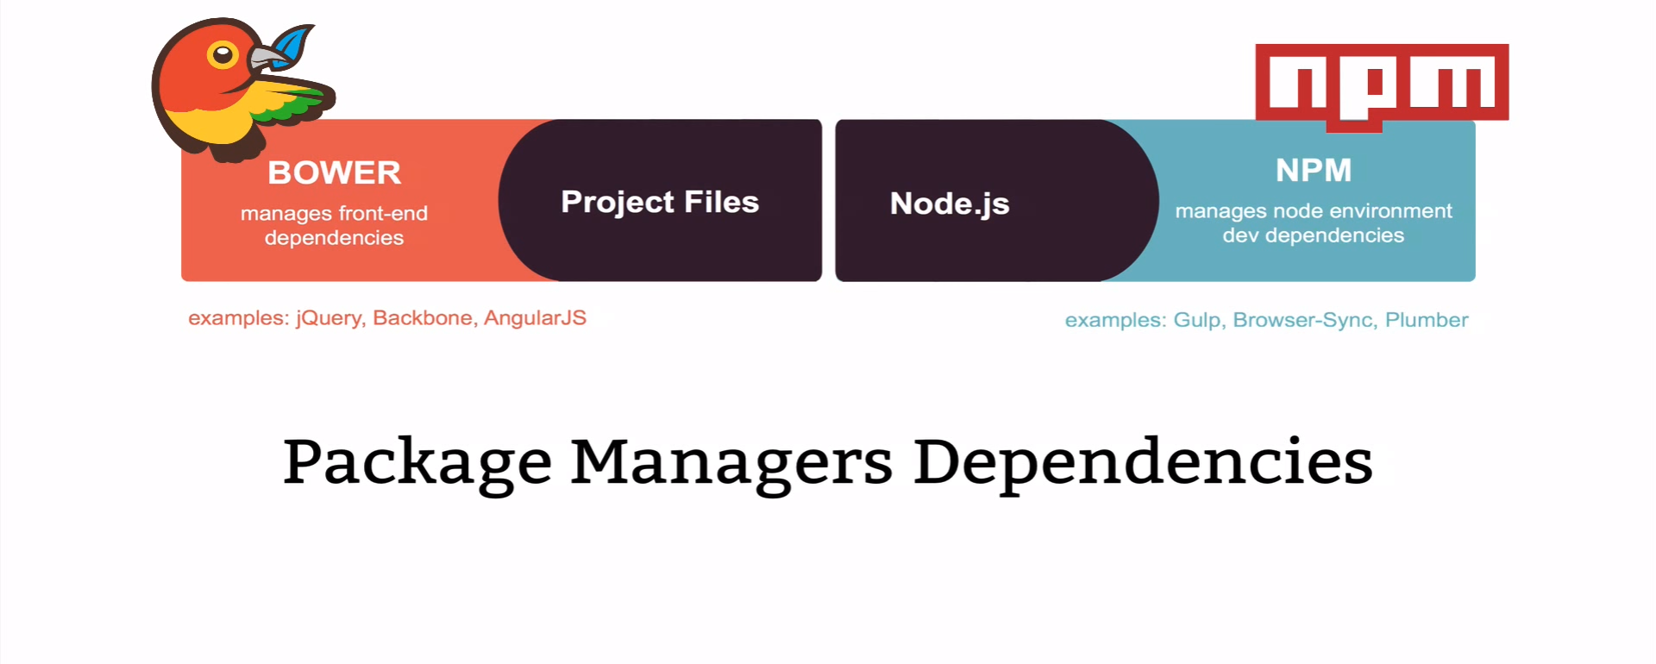
Package Managers – Bower & NPM

Slide 15
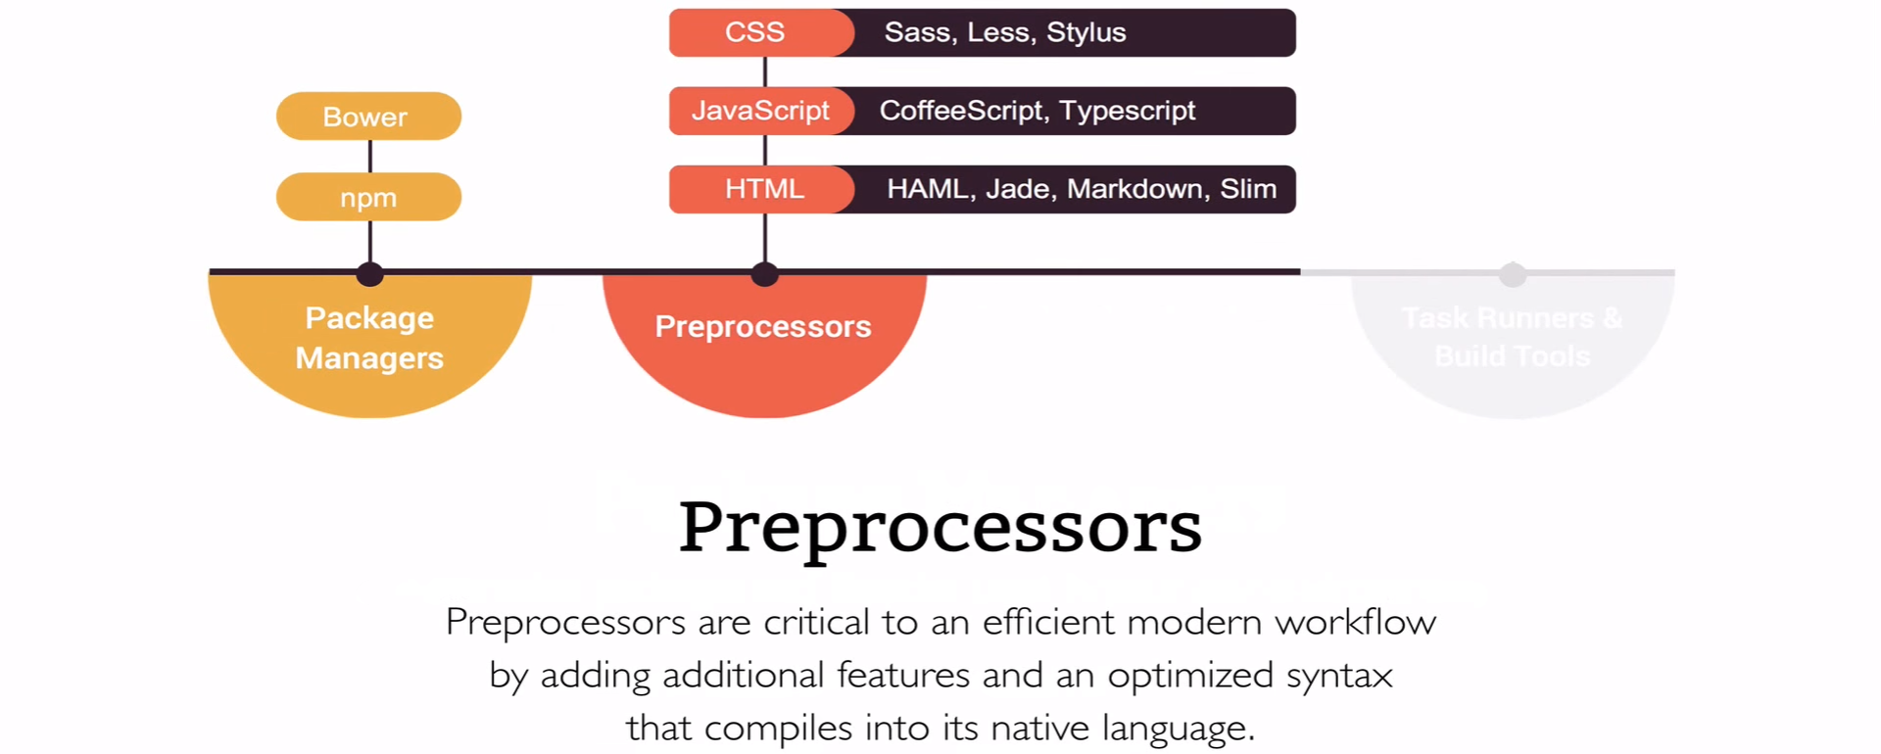
What are Preprocessors

Slide 16
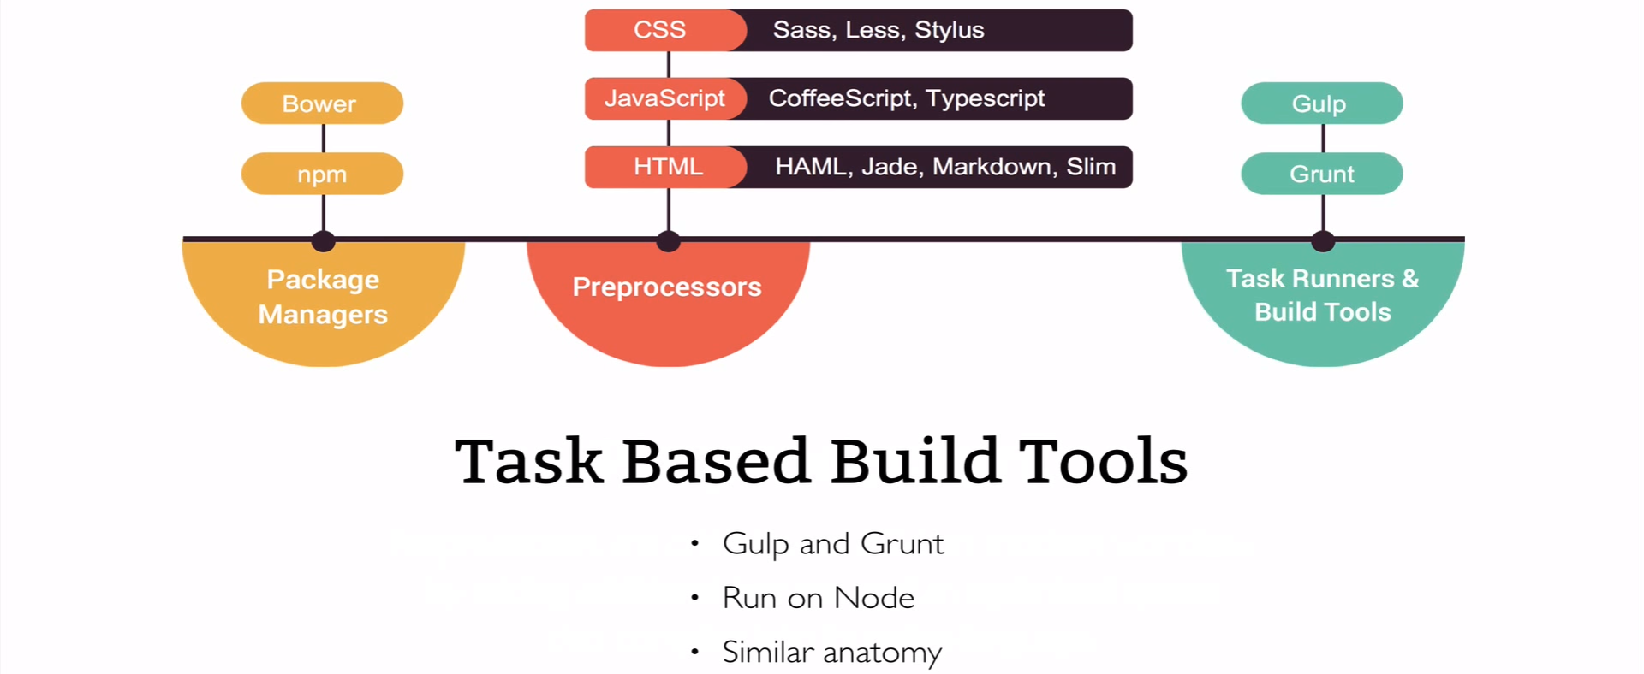
Task Runners – Gulp & Grunt

Slide 17

Gulp Vs Grunt

Slide 18
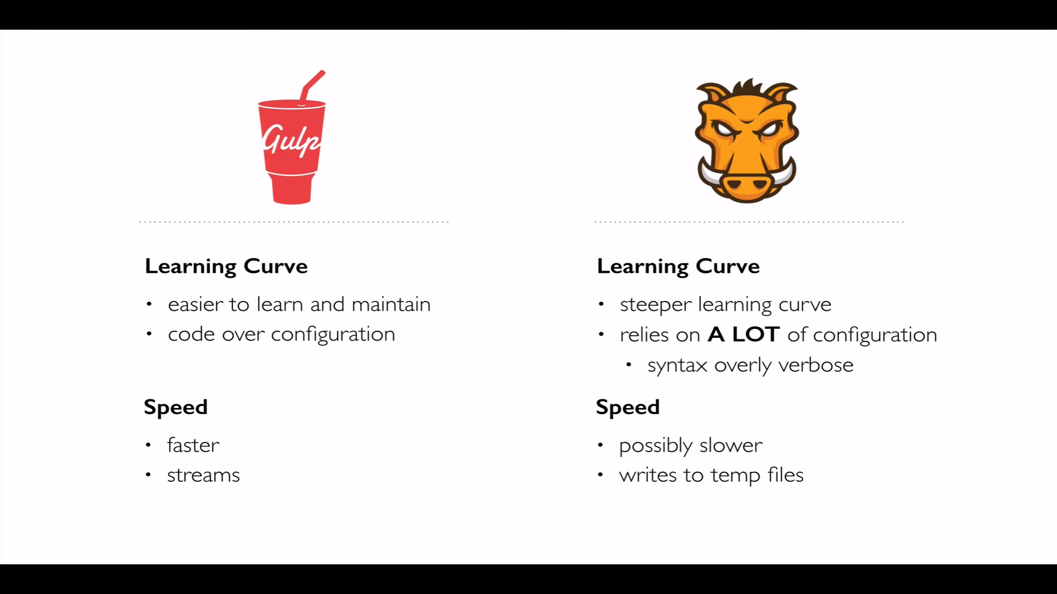
Gulp Vs Grunt

Slide 19
Gulp Vs Grunt

Slide 20
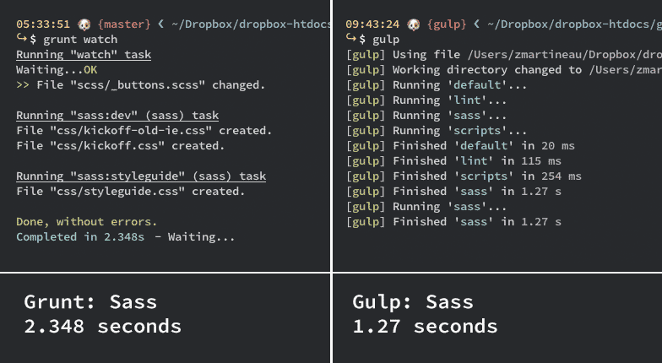
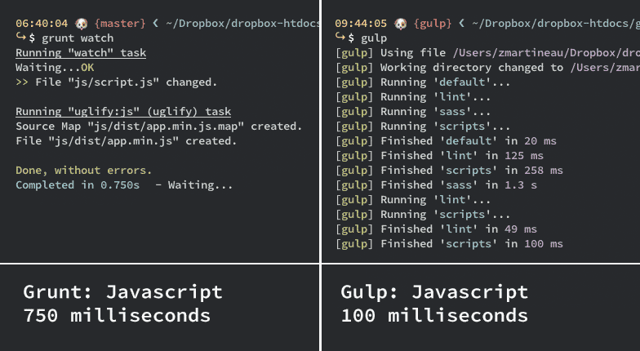
Gulp Vs Grunt
A speed comparison was done below sample. which shows that most tasks are at least twice as fast on Gulp.
While this wasn’t a hugely scientific study the tendency is there and I’ve seen the same with my own projects.
But how big of an impact is the difference in speed?
Sass compilation JavaScript minification and concatenation using Uglify.js

Slide 21
What is Gulp?
AUTOMATE YOUR TASKS
EASILY WITH GULP.JS

Slide 22
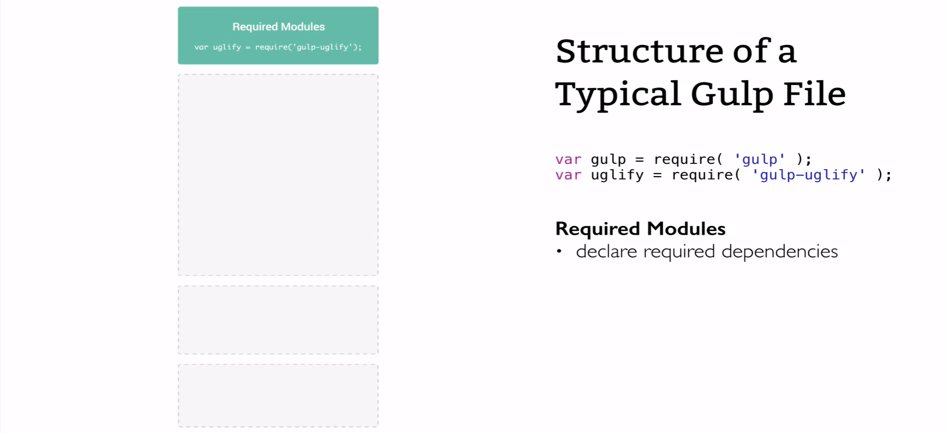
Gulp – File Structure

Slide 23
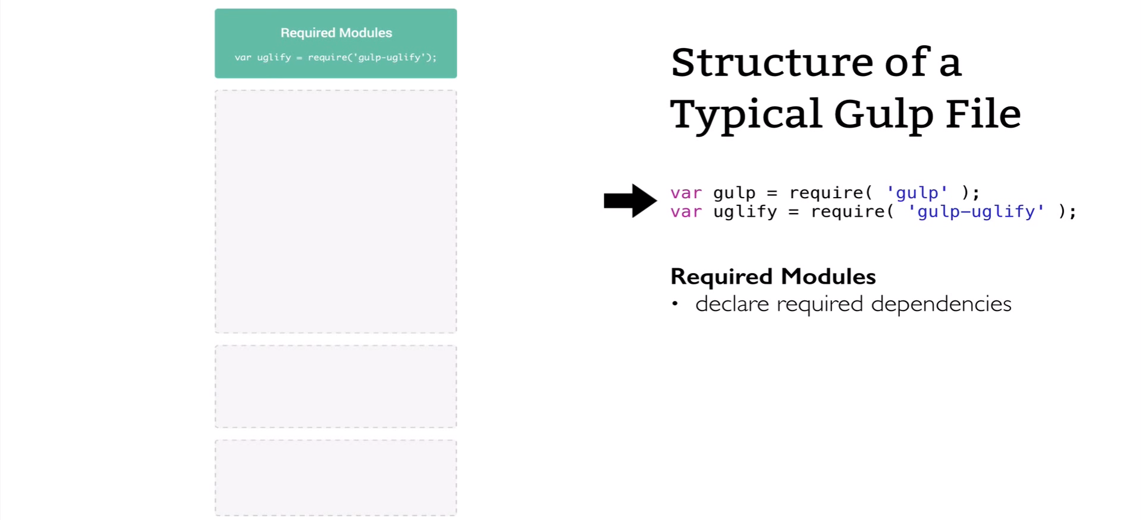
Gulp – File Structure

Slide 24
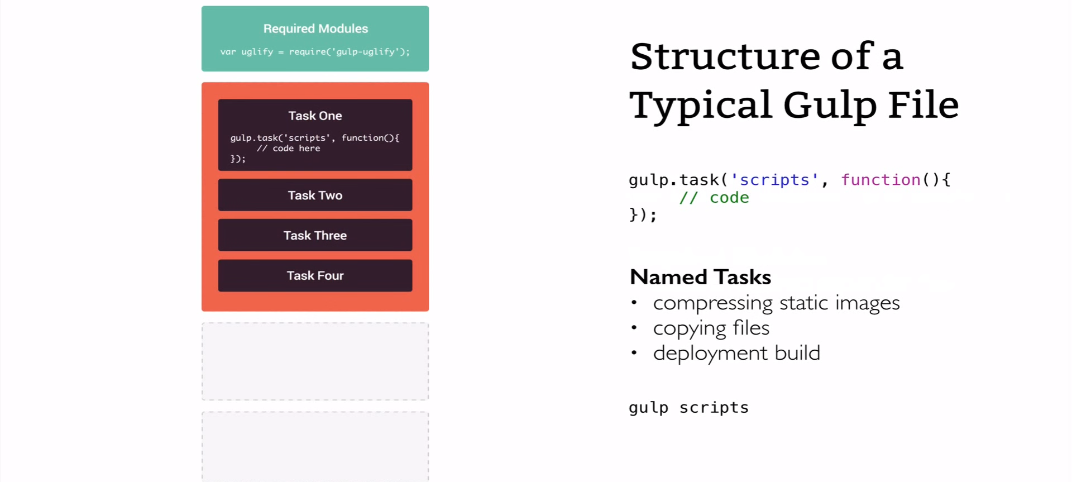
Gulp – File Structure

Slide 25
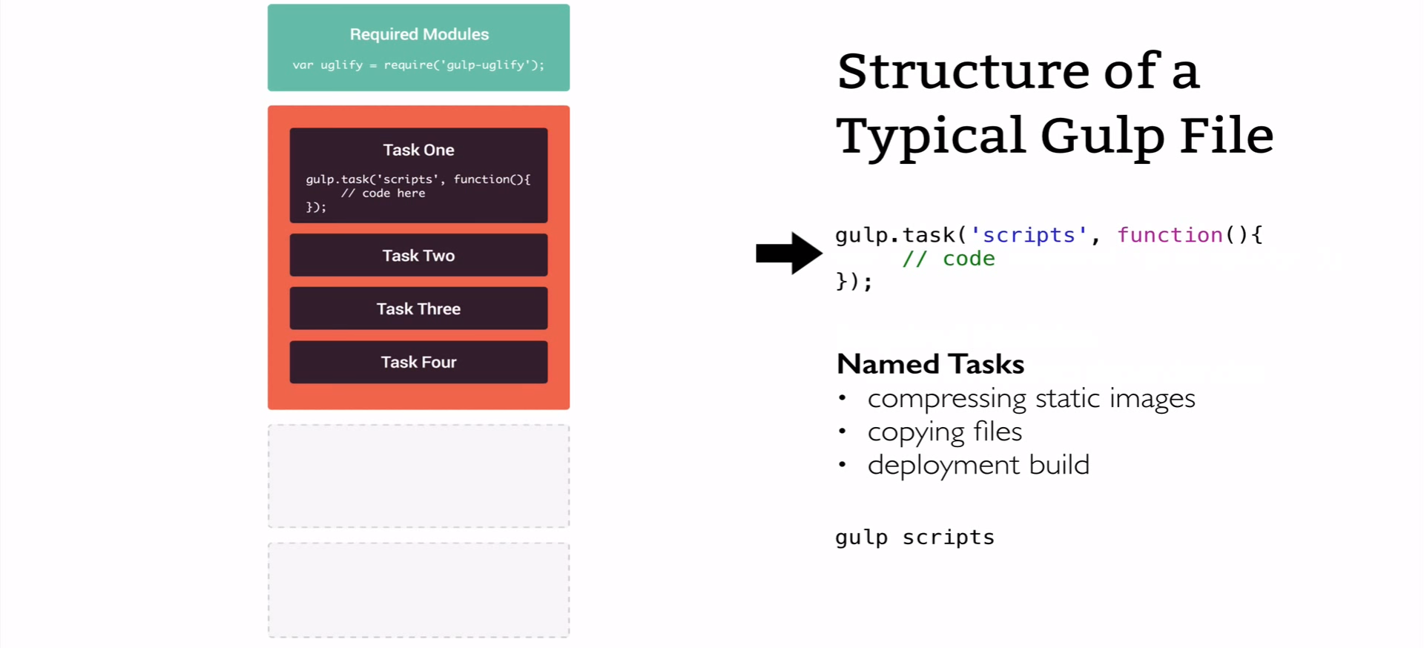
Gulp – File Structure

Slide 26
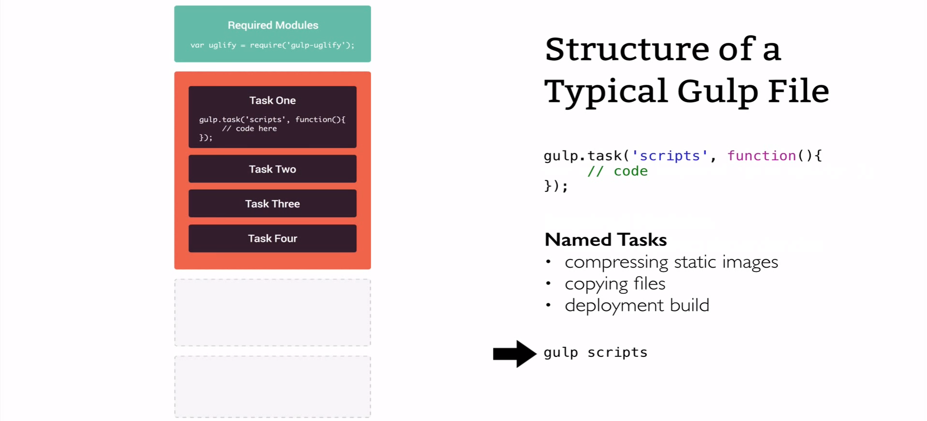
Gulp – File Structure

Slide 27
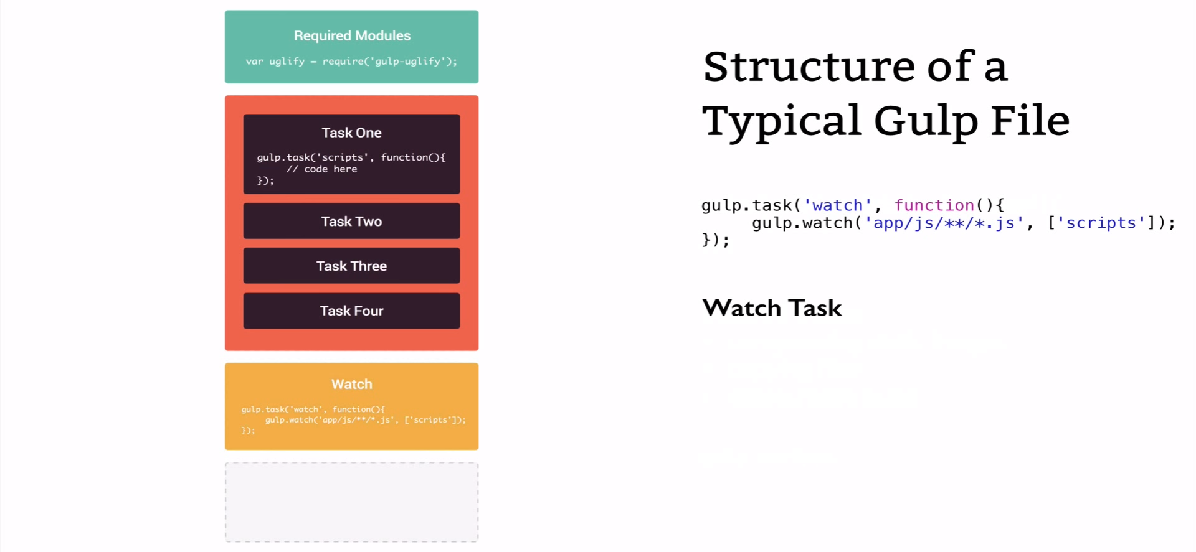
Gulp – File Structure

Slide 28
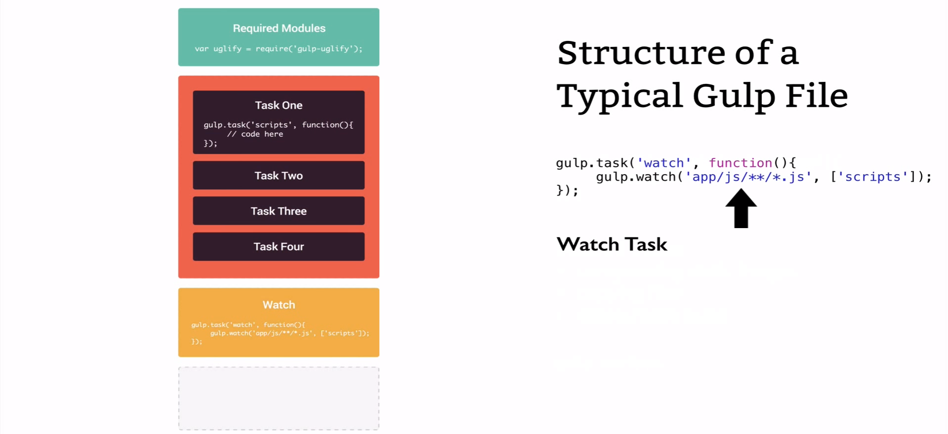
Gulp – File Structure

Slide 29
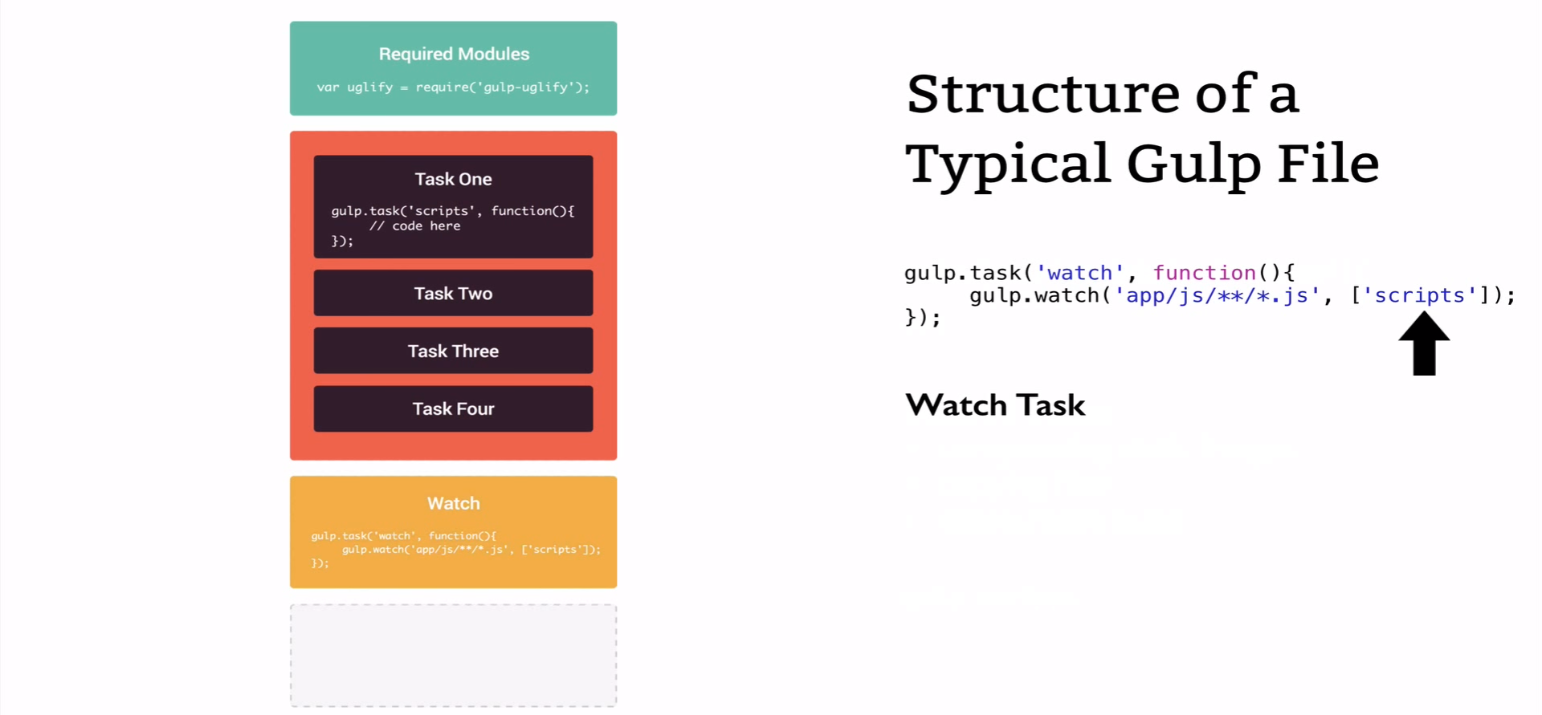
Gulp – File Structure

Slide 30
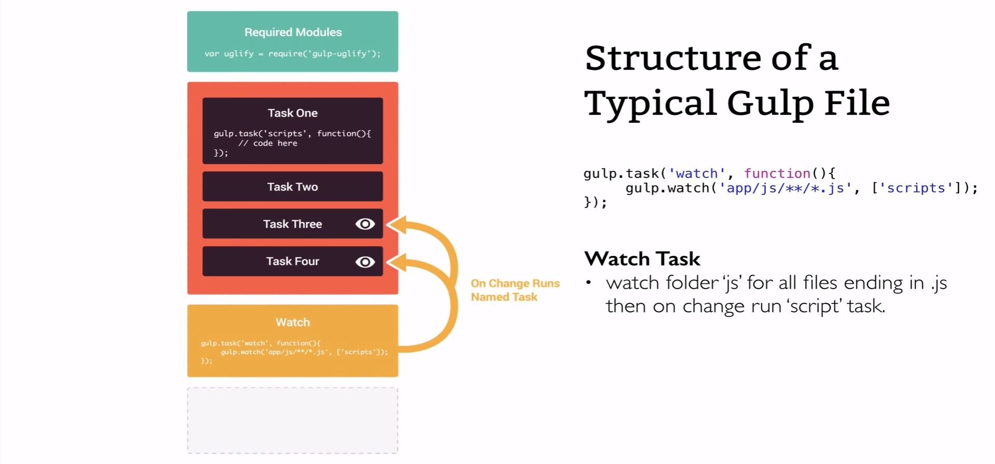
Gulp – File Structure

Slide 31
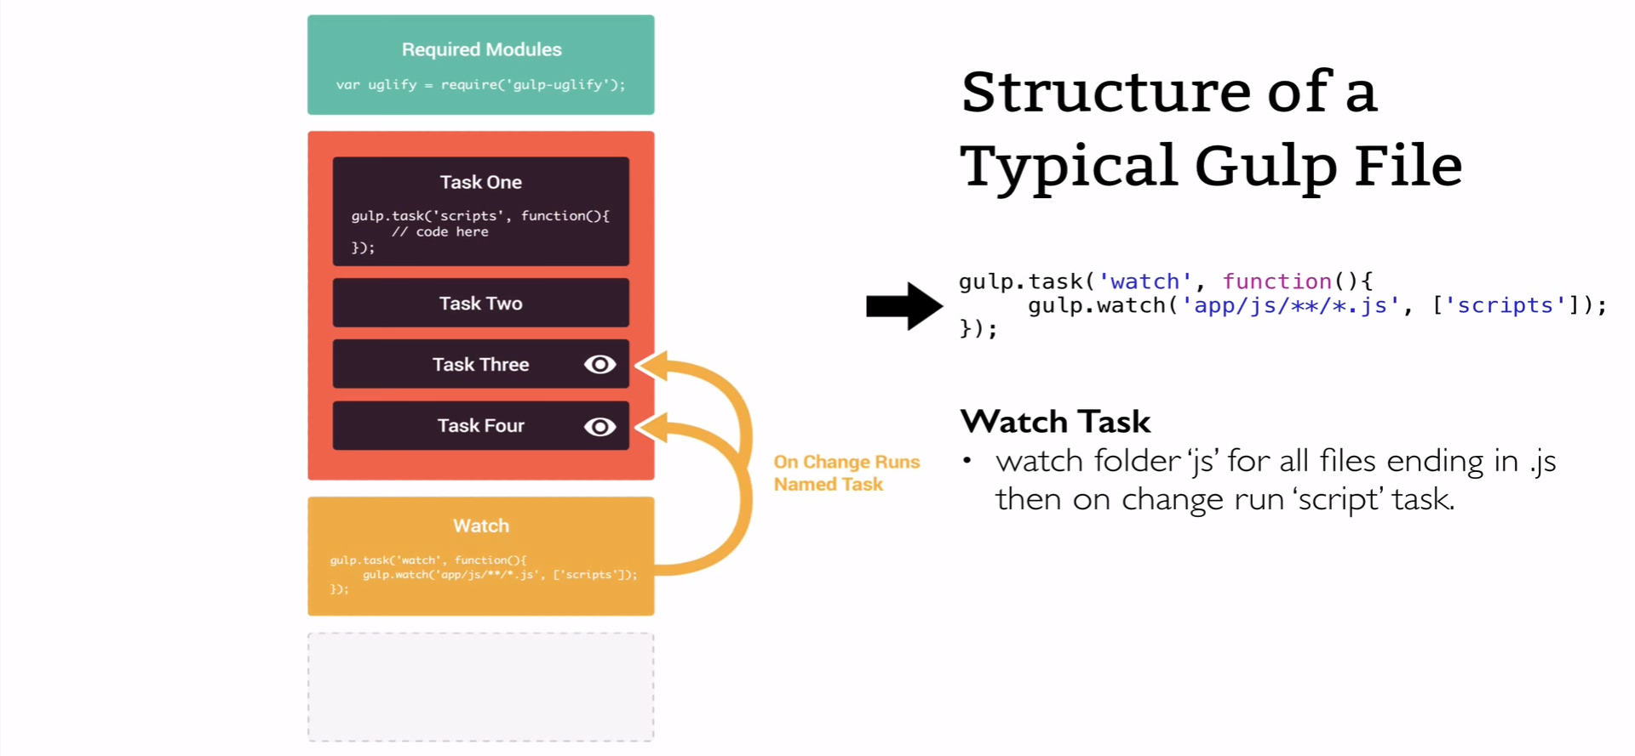
Gulp – File Structure

Slide 32
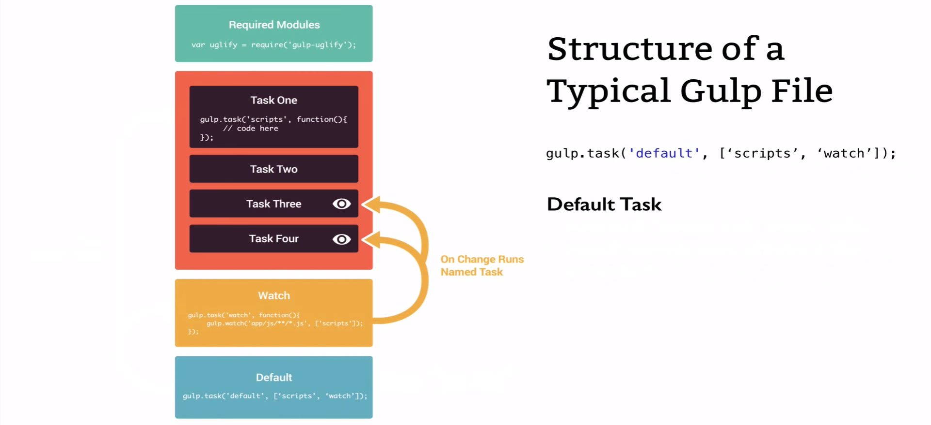
Gulp – File Structure

Slide 33
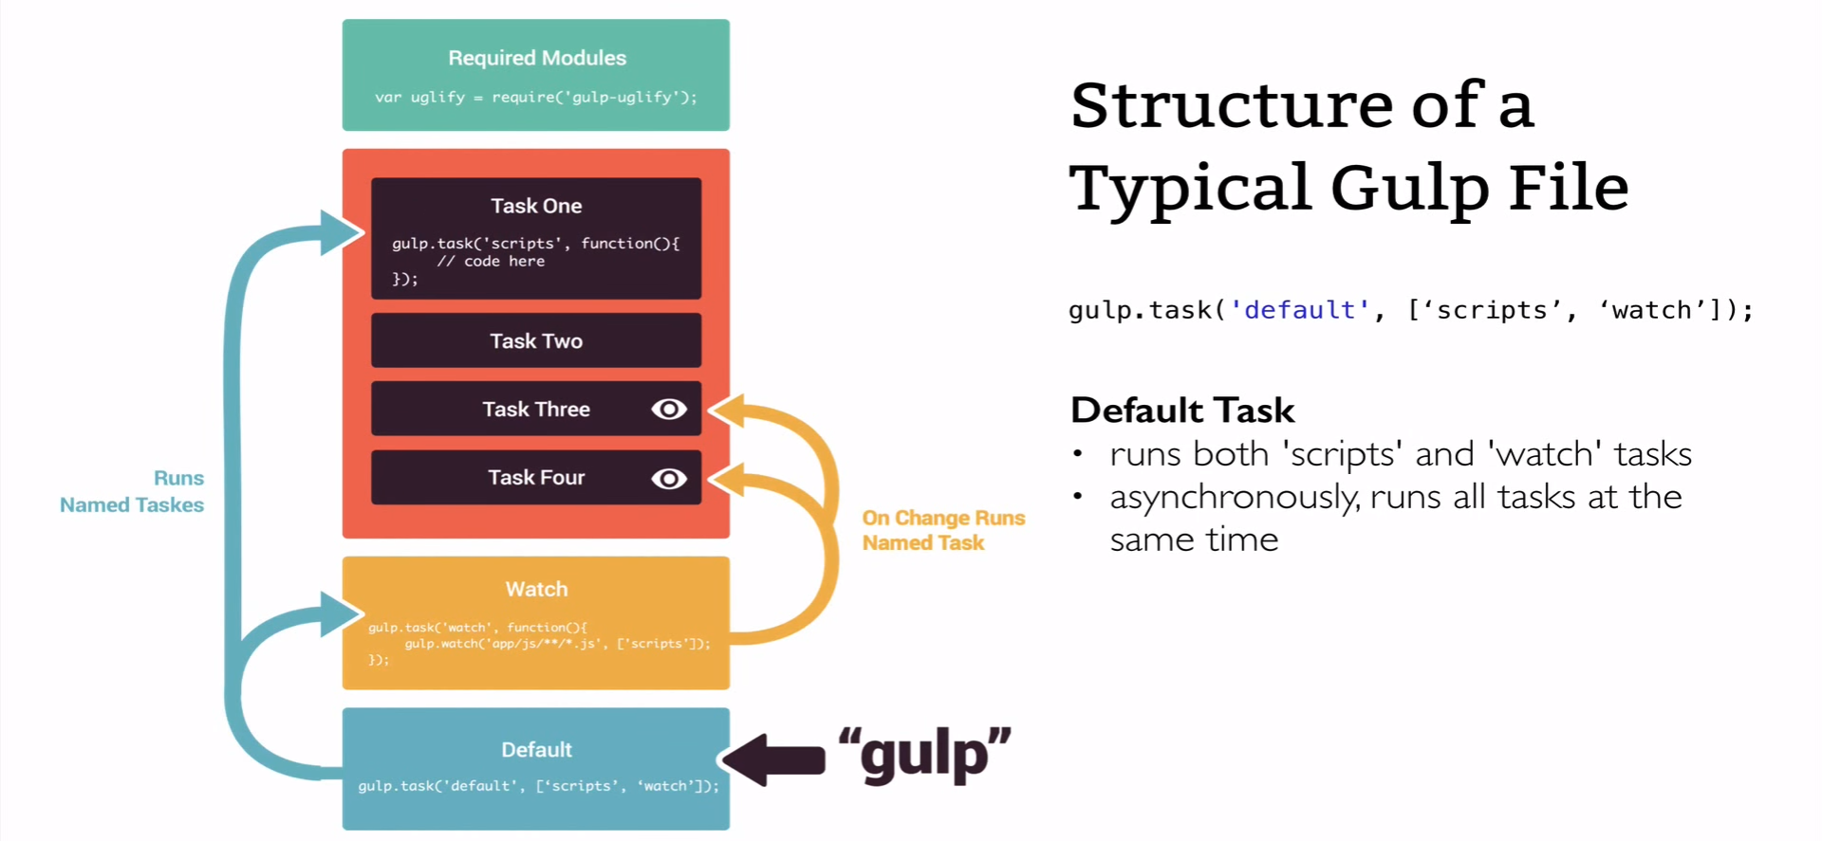
Gulp – File Structure

Slide 34
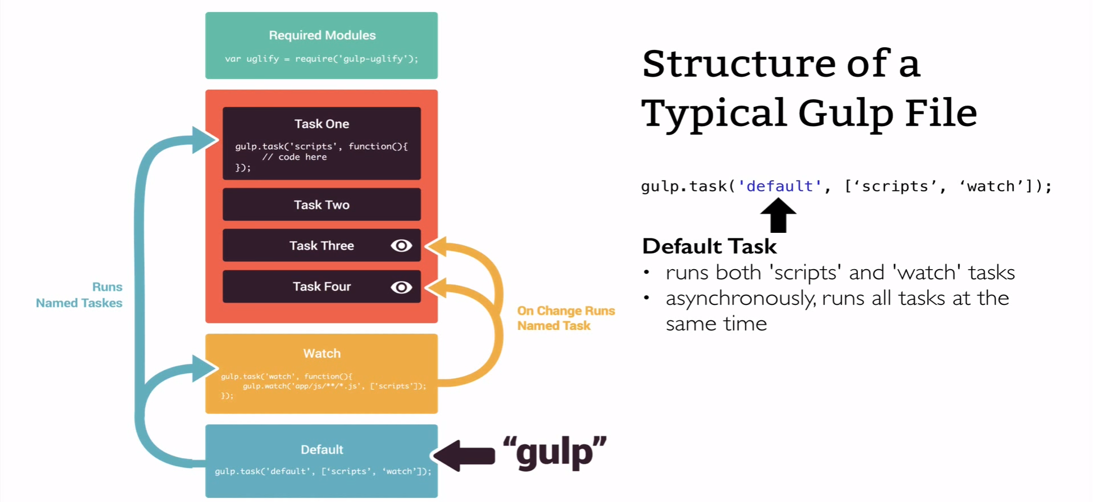
Gulp – File Structure

Slide 35
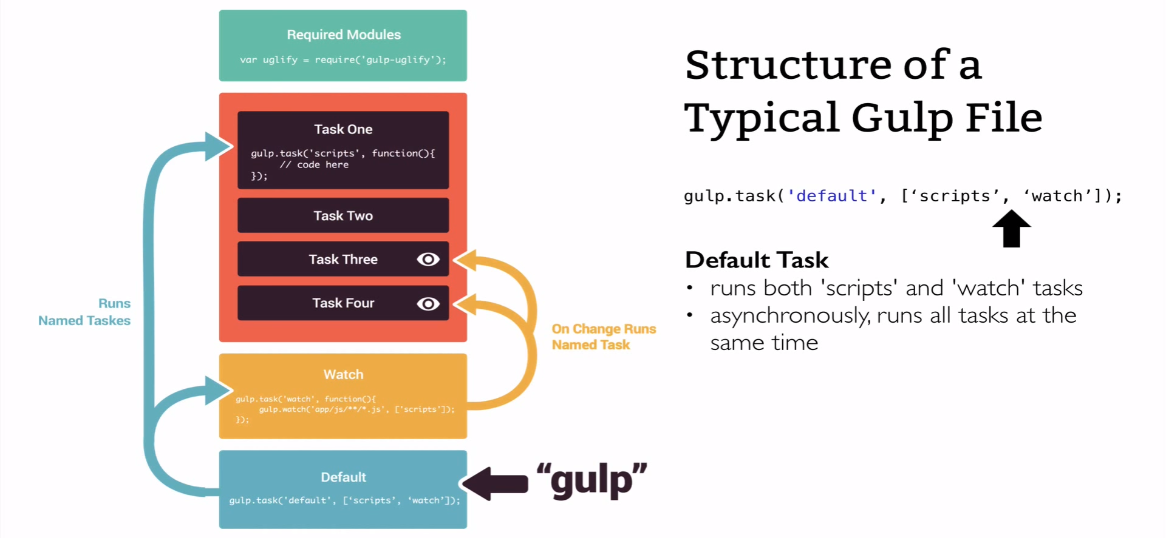
Gulp – File Structure

Slide 36

Gulp – File Structure

Slide 37
Demo Key points
We will make a quick project to demonstrate some of the most frequent front-end development tasks you'll encounter, and create an integrated workflow.
Setting up an automated workflow.
Generating HTML from templates and content files.
Compiling Sass to CSS code.
Do asset compilation (concatenation and minification).
Watch for change in your files and act on it.
Automatically reload the page in the browser after change.

Slide 38
Setting up an automated workflow :
Install Node.js
Create package.json and list dependencies (Gulp and plugins).
Install Gulp.
Create gulpfile.js.
Install, Load NPM modules and create tasks.
Prerequisites
Gulp is a command line tool, so you should be familiar working in terminal. In order to use Gulp you need to have Node.js installed on your system.

Slide 39
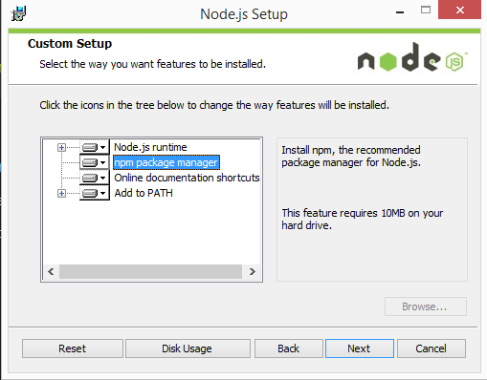
1. Install Node.js
Installation Steps
Download the Windows installer from the Nodes.js® web site.
Run the installer (the .msi file you downloaded in the previous step.)
Follow the prompts in the installer (Accept the license agreement, click the NEXT button a bunch of times and accept the default installation settings).
Restart your computer. You won’t be able to run Node.js® until you restart your computer.

Slide 40
2. Create package.json and list dependencies
To create a package.json run:
npm init
This will initiate a command line questionnaire that will conclude with the creation of a package.json in the directory you initiated the command.
// package.json
{
"name": "demo",
"version": "1.0.0",
"description": "gulp demo for level 200 training",
"main": "gulpfile.js",
"scripts": {
"test": "echo \"Error: no test specified\" && exit 1"
},
"author": "",
"license": "ISC“ }

Slide 41
3. Installing Gulp
Install the gulp command
npm install --global gulp-cli
Install gulp in your devDependencies
Run this command in your project directory:
npm install --save-dev gulp

Slide 42
4. Create a gulpfile.js
Create a file called gulpfile.js in your project root with these contents:
Test it out
Run the gulp command in your project directory:
gulp
var gulp = require('gulp');
gulp.task('default', function() {
// place code for your default task here
});

Slide 43
5. Create tasks using below methods
gulp.task – defines a new task with a name, optional array of dependencies and a function.
gulp.src – sets the folder where source files are located.
gulp.dest – sets the destination folder where build files will be placed.
gulp.watch - Watch for change in your files and act on it
Any number of plug-in calls are set with pipe between the .src and .dest.

Slide 44
Task 1: Install & Compile Twig templates with Gulp
Install gulp in your devDependencies
Run this command in your project directory:
npm install gulp-twig --save-dev
var twig = require('gulp-twig');
gulp.task('twig', function() {
return gulp.src('twig/*.twig')
.pipe(twig())
.pipe(gulp.dest('app/'));
});

Slide 45
Task 2: Install & Compiling Sass to CSS code
Install gulp in your devDependencies
Run this command in your project directory:
npm install gulp-sass --save-dev
npm install gulp-clean-css --save-dev
npm install gulp-rename --save-dev
npm install browser-sync --save-dev

Slide 46
Task 2: Install & Compiling Sass to CSS code
var sass = require('gulp-sass'),
cleanCSS = require('gulp-clean-css'),
rename = require("gulp-rename"),
browserSync = require('browser-sync').create();

Slide 47
Task 2: Install & Compiling Sass to CSS code
gulp.task('sass', function() {
return gulp.src([
'scss/*.scss' // SASS & SCSS Source folder
])
.pipe(sass().on('error', sass.logError)) // Compiling Sass to CSS code
.pipe(gulp.dest('css/')) // Destination path unminified CSS
.pipe(cleanCSS()) // Minification
.pipe(rename({
suffix: '.min' // Rename css minified file
})).pipe(gulp.dest('app/css/')) // Desitnation path minified CSS
.pipe(browserSync.stream()); // auto-inject into browsers
});

Slide 48
Task 3: Do asset Concatenation and Uglify
Install gulp in your devDependencies
Run this command in your project directory:
npm install gulp-concat --save-dev
npm install gulp-uglify --save-dev

Slide 49
Task 3: Do asset Concatenation & Uglify
gulp.task('vendor', function() {
return gulp.src(['vendor/jquery/dist/jquery.js',
'vendor/bootstrap-sass/assets/javascripts/bootstrap.js',
'vendor/slick-carousel/slick/slick.js'
]).pipe(concat('vendor.js'))
.pipe(uglify())
.pipe(rename({
suffix: '.min'
})).pipe(gulp.dest('app/js/'));
});
gulp.task('scripts', function() {
return gulp.src('js/*.js')
.pipe(concat('custom.js'))
.pipe(uglify())
.pipe(rename({
suffix: '.min'
}))
.pipe(gulp.dest('app/js/'));
});

Slide 50
Task 4: Watching Files & Browser sync
Browser sync is the one plugin that helps us improve frontend productivity the most. It creates a local server that automatically reloads web pages when source code changes are saved. Oh, and it also synchronizes every local page together: ​
Here's how you'd integrate a Browser sync task into your gulpfile: ​
gulp.task('serve', ['sass', 'vendor', 'scripts', 'twig'], function() {
browserSync.init({
server: { baseDir: "./app" }
});
gulp.watch("scss/**/*.scss", ['sass', browserSync.reload]);
gulp.watch("js/**/*.js", ['js', browserSync.reload]);
gulp.watch("twig/**/*.{twig,tpl,html}", ['twig', browserSync.reload]);
});

Slide 51
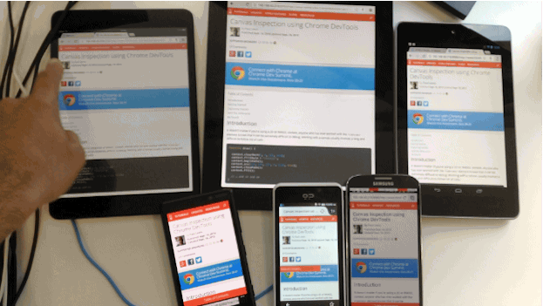
Task 5. Browser sync

Slide 52


